Slide 1

Web Dev 101
Session 1
About the Course
How the Internet Works
Web Technologies
Course plan
Learning Resources
HTML

Slide 2






About the course
Aimed at complete Beginners, and anyone with or without coding experience looking to increase their coding skills and considering making their own website or being a web developer.
About Me
cleaopatraintech
eydandash
Esraa Dandash
cleaopatraintech
eydandash
My Name is Esraa Dandash, I am:
-3rd Year Comp Sci at City.
-Trainee (digital office) at Societe Generale bank, London.
-Vice President at City Tech Soc.
-A Mechanical Eng. Student turned WiT and Web Dev instructor –starting today-! I go by Cleopatra In Tech!
-Lead Organiser for HackCity2019.
-Some other things that won’t fit….

Slide 3
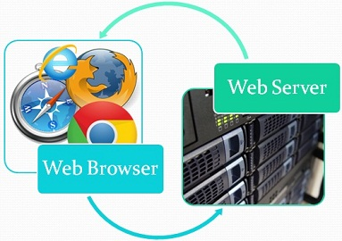
How the Internet Works
Let’s take this Example: You open you browser, and Type in www.facebook.com.
What happens??

Slide 4
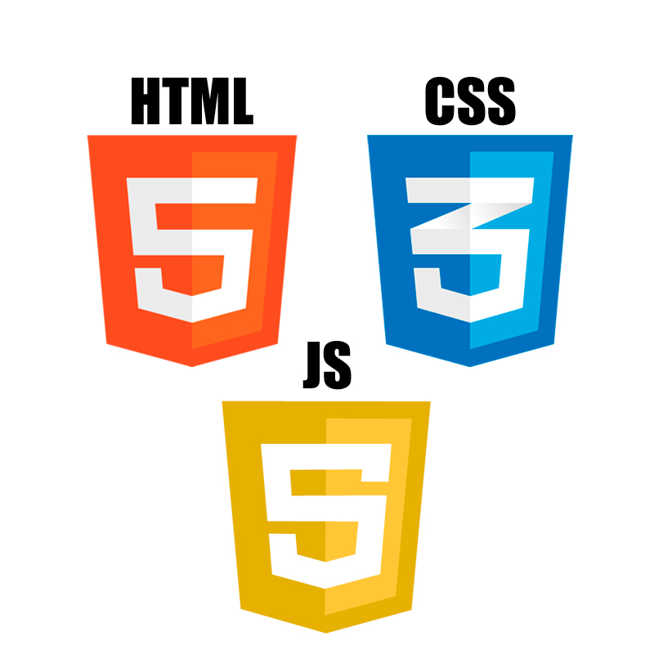







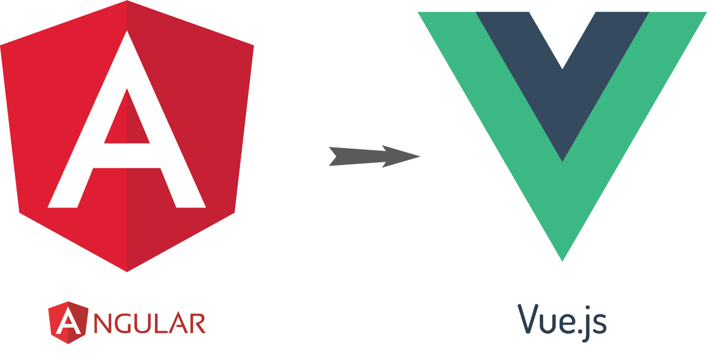
Web Technologies
Foundation:
HTML
CSS
Programming Languages:
JavaScript
TypeScript
Python
Frameworks
Front-End Frameworks:
(Client side language)
Bootstrap
Angular.js
React.js
Vue.js
Back-End Frameworks:
(Server side language)
Node.js
Django
Ruby On Rails

Slide 5
Course Timeline & Resources
Advanced CSS & BS4
Advanced HTML and CSS
Week 2
Intro & HTML
Week 1
Week 3
Week 4
Build our first Website
Week 5
Basic JS & JQuery
Week 6
Spicing up our first Website
Resources will be added to every session’s Resources section on GitHub, please notice that due to time restrictions, I really, really do recommend going through them in your own free time because we will not be able to cover verything in the sessions.

Slide 6
Let’s Start: HTML
Open github.com and sign up if you don’t have an account.
Go to https://github.com/eydandash/CityTechSoc-WebDev-101/
Bookmark this page if you would like to reach it easily every session.
Download Session 1 and Find the resources in the recourses menu for every session.
Open index.html in your text editor (Exercise 1)
Follow the comments!
Solutions to the exercise will be in the same session folder as S1.html but give it a try first.
The cheat sheet provided in the first point under resources is very recommended to get an idea of different HTML tags.
See you next Monday 💻💥

